Slide 1
WIT Administrator Updates to ISAS/ATFWG
Kokou Agbassekou
Eric Vaa
02/16/2023

Slide 2
WIT WebSmartScheduler (WIT SS) Updates
Parallel operations is on-going
All BAs should now have access to production WIT SS
Interchange Schedules seem to be transferring to the new environment
OATI is working with some entities to set up the meter actual data flow to both the current and the new WIT.
Stakeholder meeting is held every Wednesday from 10-11 PST (meeting link: Join meeting)
Production cutover is currently planned on March 1, 2023
If you have any questions about your data or environment talk directly to OATI. Laura L. Wollan Laura.Wollan@oati.net ; Jeremy West Jeremy.West@oati.net or Eric Arnold Eric.Arnold@oati.net

Slide 3
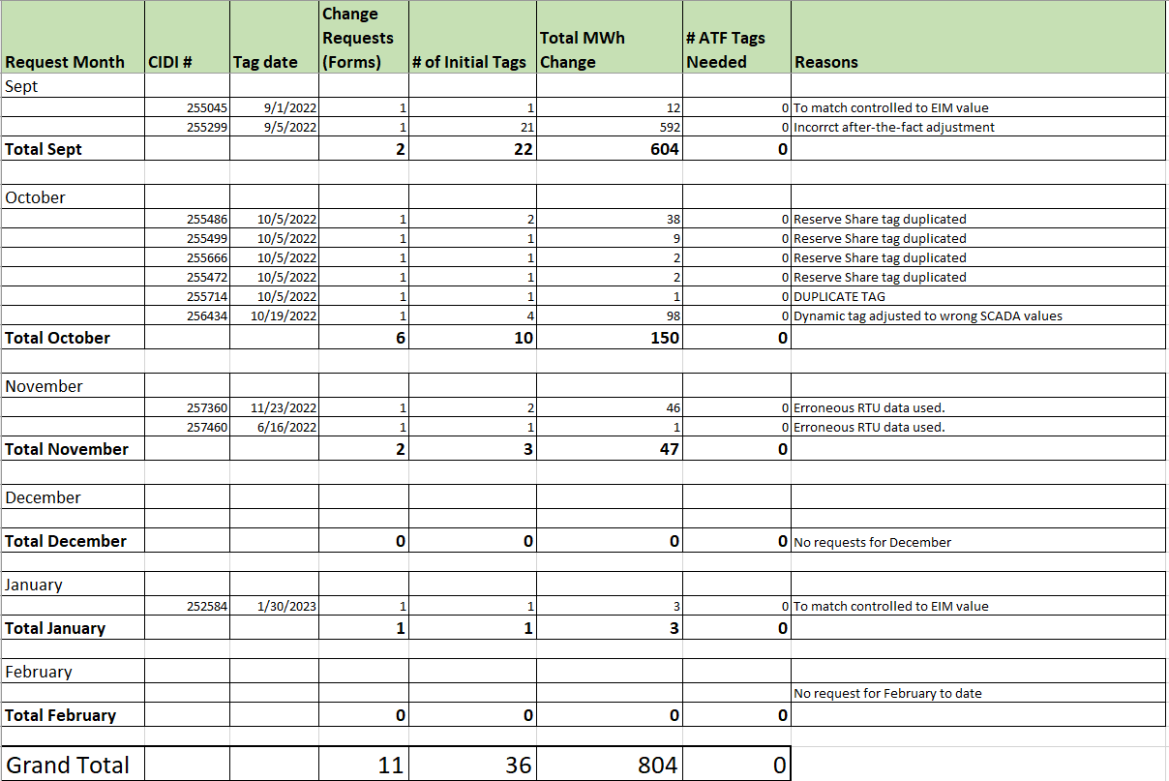
WIT Schedule Change Report (Sept 2022-Jan 2023)

Slide 4
California ISO EIM Market Updates
List of EIM entities that joined the ISO market summer 2022.
Avista Utilities
Bonneville Power Administration (BPA)
Tacoma Power
Tucson Electric Power (TEP)
List of new EIM entities who planned/onboarding through spring 2023 (Likely April 2023).
Avangrid Renewables
El Paso Electric
WAPA – Desert Southwest

Slide 5
California ISO EIM Market Updates
Since its inception in November 2014, gross benefits from participation in the Western Energy Imbalance Market (WEIM) is $3.40 billion.
The measured benefits of participation in the WEIM include cost savings, increased integration of renewable energy, and improved operational efficiencies including the reduction of the need for real-time flexible reserves.
The WEIM Quarterly Benefits reports found on the WEIM webpage provide the benefit of economic dispatch in the real time market across a larger WEIM footprint with diverse resources and geography.

Slide 6
California ISO EIM Market Updates
The latest report from Q4 2022 can be found using this link: https://www.westerneim.com/Documents/iso-western-energy-imbalance-market-benefits-report-q4-2022.pdf. This report breaks down the following benefits economically, environmentally and operationally as follows:
Economical $485.29 M Gross benefits realized due to more efficient inter-and intra-regional dispatch in the Fifteen-Minute Market (FMM) and Real-Time Dispatch (RTD)*
Environmental 10,960 Metric tons of CO2 avoided curtailments
Operational 58% Average reduction in flexibility reserves across the footprint

Slide 7
Questions?

